Slide 1
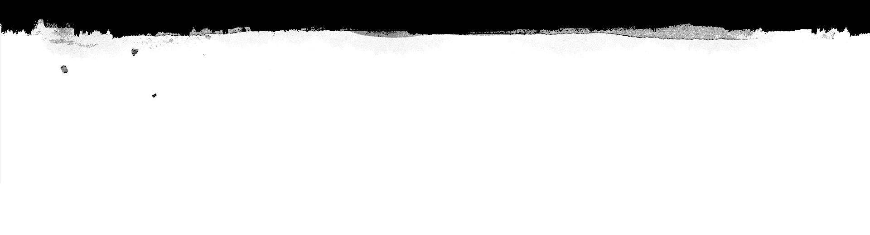

Computational Intelligence (TC2023)

Slide 2
Unit 3 – Anomaly Detection (3)
Outline
What is a Neural Network?

Slide 3

What is a Neural Network?

Slide 4
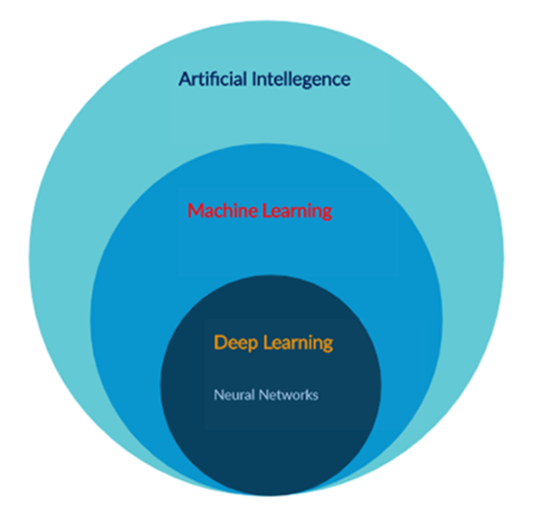
What is neural network?
A neural network¹ is a series of ML algorithms that endeavors to recognize underlying relationships in a set of data through a process that mimics the way the human brain operates.
In this sense, neural networks refer to systems of neurons, either organic or artificial in nature.
It is the heart of deep learning algorithms.
Neural networks take input data, train themselves to recognize patterns found in the data, and then predict the output for a new set of similar data.
Neural networks, also known as artificial neural networks (ANNs) or simulated neural networks (SNNs)

Slide 5
Applications in an ANN?
Classification of data: Based on a set of data, our trained neural network predicts whether it is a dog or a cat?
Anomaly detection: Given the details about transactions of a person, it can say that whether the transaction is fraud or not.
Speech recognition: We can train our neural network to recognize speech patterns. Example: Siri, Alexa, Google assistant.
Audio generation: Given the inputs as audio files, it can generate new music based on various factors like genre, singer, and others.
Time series analysis: A well trained neural network can predict the stock price.
Spell checking: We can train a neural network that detects misspelled spellings and can also suggest a similar meaning for words. Example: Grammarly
Character recognition: A well trained neural network can detect handwritten characters.
Machine translation: We can develop a neural network that translates one language into another language.
Image processing: We can train a neural network to process an image and extract pieces of information from it.

Slide 6
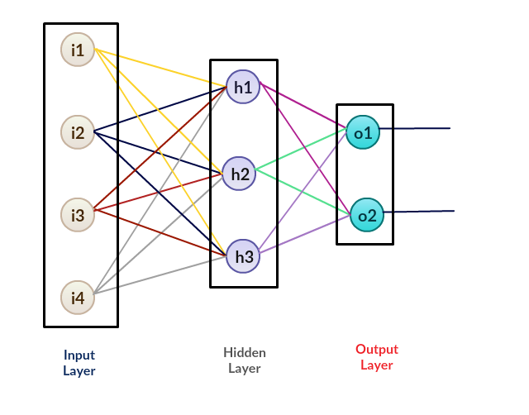
General Structure of an ANN

Slide 7
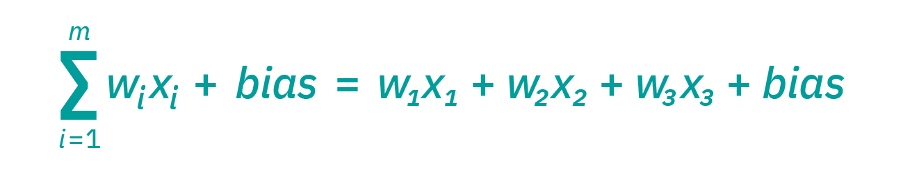
How do neural networks work?
Think of each individual node as its own linear regression model, composed of input data, weights, a bias (or threshold), and an output.
The AAN learns the values to weights that fit better.
Weight decides how vital is that feature for our prediction.

Slide 8
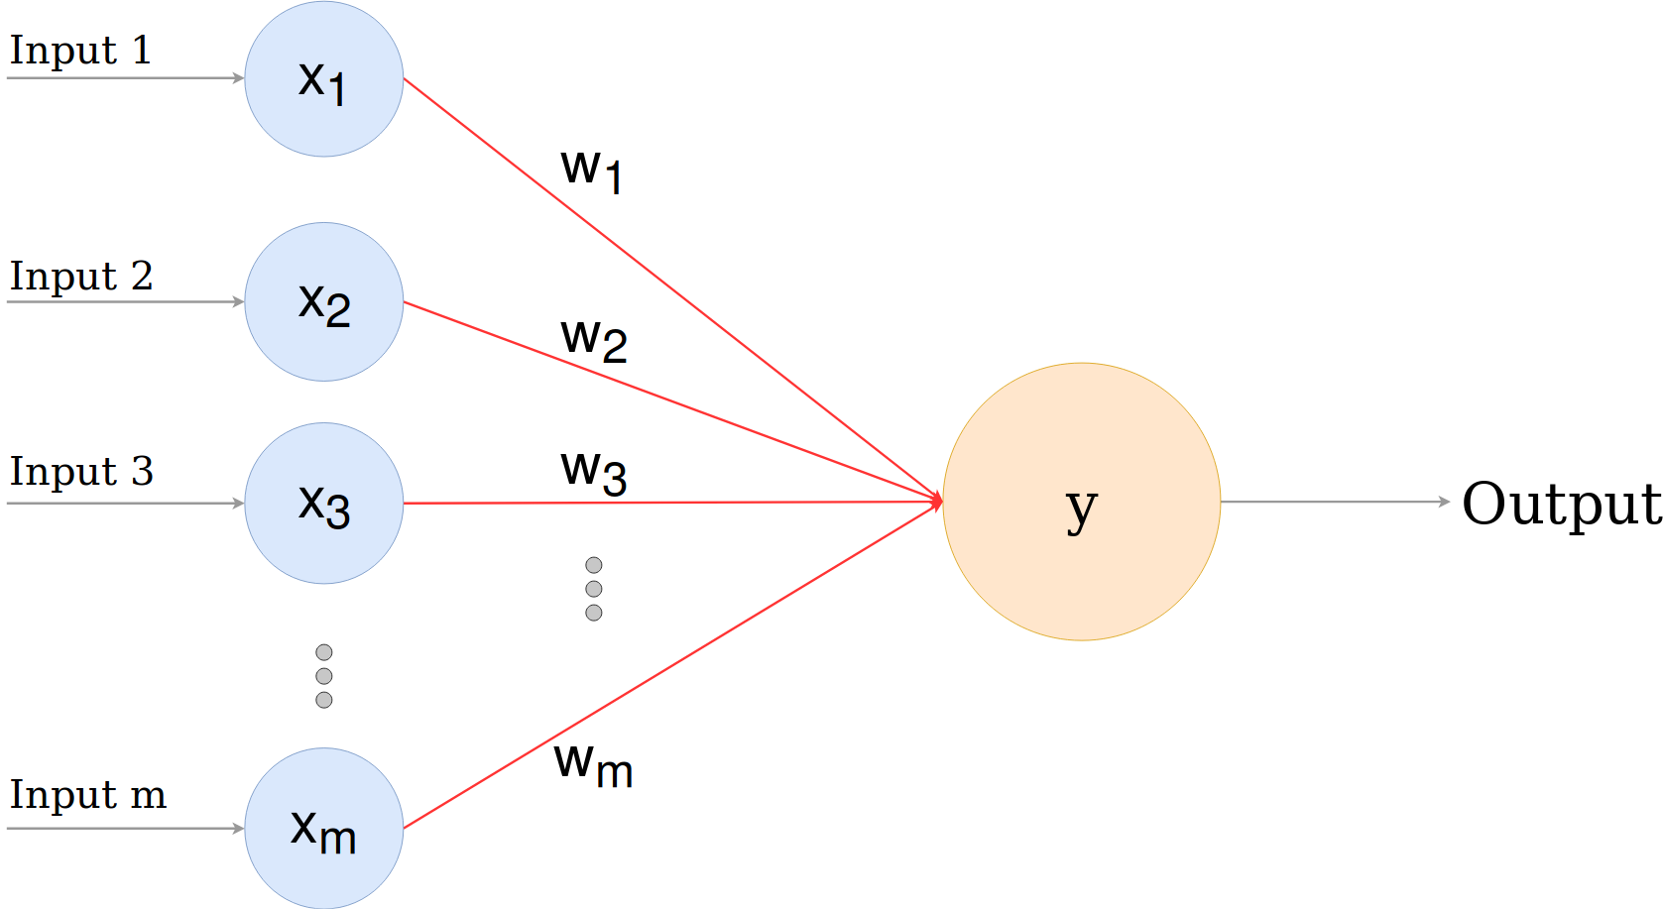
Perceptron
Were developed in the 1950s and 1960s by the scientist Frank Rosenblatt, inspired by earlier work by Warren McCulloch and Walter Pitts.
A perceptron is a neural network without any hidden layer.
A perceptron only has an input layer and an output layer.
The function f (y) is non-linear and transform the input into outputs and is called the Activation Function.

Slide 9
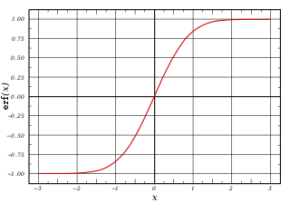
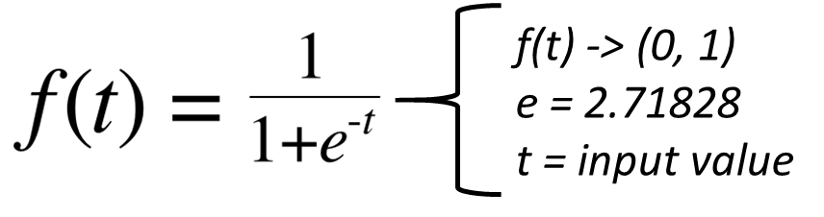
Activation Function
Function that defines the output of that node given an input or set of inputs.
Example: Sigmoid Function

Slide 10
How ANN Works?
Feedforward: On a feedforward neural network, we have a set of input features and some random weights.

Slide 11
How ANN Works?
Backpropagation: phase where we calculate the error between predicted output and target output and then use an algorithm (gradient descent) to update the weight values.

Slide 12
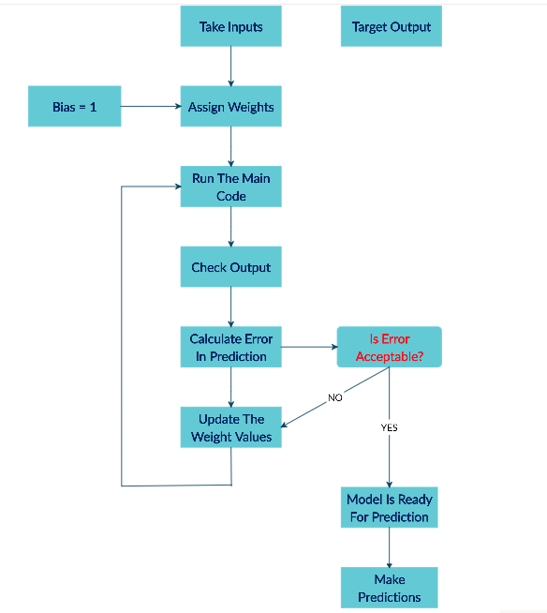
How ANN Works?

Slide 13
Perceptron Example
i1
w1
Activation function
i2
w2
Σ
Output
i3
w3
bias = bias * weight for bias
Input | Output
0 | 6
1 | 2
2 | 4
Input | Output | Predict (W=3) | Error (W=3)
0 | 6 | 0+3+6 = 9 | 3
1 | 2 | 3 | 1
2 | 4 | 6 | 3
Input | Output | Predict (W=2) | Error (W=3) | Error (W=2)
0 | 6 | 0+2+4 = 8 | 3 | 2
1 | 2 | 2 | 1 | 0
2 | 4 | 4 | 3 | 0
W=3
W=2
Output
Consider bias = 1
Error (W=2) < Error (W=3), so W=2 is a best answer than W=3

Slide 14
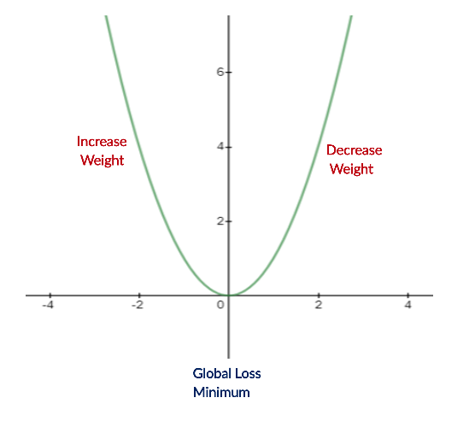
Perceptron Example
i1
w1
i2
w2
Σ
Output
i3
w3
bias = bias * weight for bias
Input | Error (W=3) | Error (W=2)
0 | 3 | 2
1 | 1 | 0
2 | 3 | 0

Slide 15
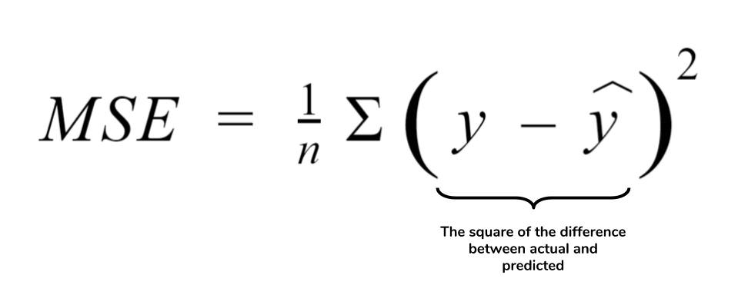
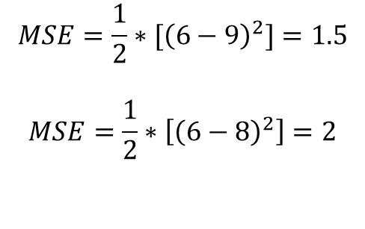
Error Calculation -> Mean Square Error (MSE)
Input | Output | Predict
0 | 6 | 9
1 | 2 | 3
2 | 6 | 8
$$MSE=\frac{1}{2}∗{[\left(6−9\right)}^{2}]=1.5$$
$$MSE=\frac{1}{2}∗\left[{\left(6−8\right)}^{2}\right]=2$$

Slide 16
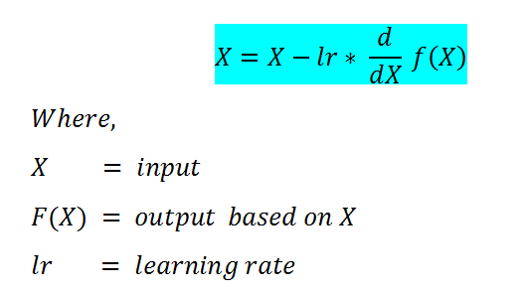
What is a Gradient Descent?
Gradient Descent is a machine learning algorithm that operates iteratively to find the optimal values for its parameters.
It considers, user-defined learning rate, and initial parameter values.

Slide 17
What is a Gradient Descent?
Start with initial values
Calculate the cost
Update values using the update function
Returns minimized cost for our cost function

Slide 18
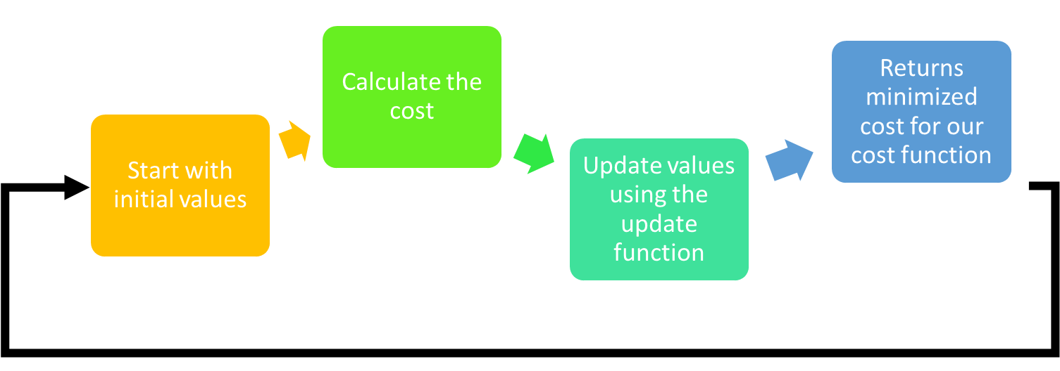
What is a Gradient Descent?

Slide 19
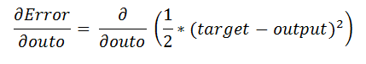
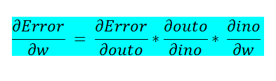
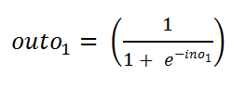
What is a Gradient Descent?
MSE
Derivation of the formula
Sigmoid Function
Check the calculus:
https://pub.towardsai.net/building-neural-networks-from-scratch-with-python-code-and-math-in-detail-i-536fae5d7bbf

Slide 20

Keras is an API designed for human beings, not machines.
Keras follows best practices for reducing cognitive load: it offers consistent & simple APIs, it minimizes the number of user actions required for common use cases, and it provides clear & actionable error messages.
It also has extensive documentation and developer guides.

Slide 21

TensorFlow is an end-to-end open-source platform for machine learning.
It has a comprehensive, flexible ecosystem of tools, libraries and community resources that lets researchers push the state-of-the-art in ML and developers easily build and deploy ML powered applications.

Slide 22
import tensorflow as tf from tensorflow import keras from tensorflow.keras import layers def build_model(): model = keras.Sequential([ layers.Dense(64, activation='relu', input_shape=[len(train_dataset.keys())]), layers.Dense(64, activation='relu'), layers.Dense(1) ]) optimizer = tf.keras.optimizers.RMSprop(0.001) model.compile(loss='mse', optimizer=optimizer, metrics=['mae', 'mse']) return model
Example of ANN Build
A Sequential model is appropriate for a plain stack of layers where each layer has exactly one input tensor and one output tensor.
Notes:
In statistics, overfitting is "the production of an analysis that corresponds too closely or exactly to a particular set of data,and may therefore fail to fit additional data or predict future observations reliably".

Slide 23
import tensorflow as tf from tensorflow import keras from tensorflow.keras import layers def build_model(): model = keras.Sequential([ layers.Dense(64, activation='relu', input_shape=[len(train_dataset.keys())]), layers.Dense(64, activation='relu'), layers.Dense(1) ]) optimizer = tf.keras.optimizers.RMSprop(0.001) model.compile(loss='mse', optimizer=optimizer, metrics=['mae', 'mse']) return model
model = build_model()
Example of ANN Build
Dense is an entry level layer which accepts the number of neurons or units (32) as its required parameter.
Notes:
In statistics, overfitting is "the production of an analysis that corresponds too closely or exactly to a particular set of data,and may therefore fail to fit additional data or predict future observations reliably".

Slide 24
import tensorflow as tf from tensorflow import keras from tensorflow.keras import layers def build_model(): model = keras.Sequential([ layers.Dense(64, activation='relu', input_shape=[len(train_dataset.keys())]), layers.Dense(64, activation='relu'), layers.Dense(1) ]) optimizer = tf.keras.optimizers.RMSprop(0.001) model.compile(loss='mse', optimizer=optimizer, metrics=['mae', 'mse']) return model
model = build_model()
Example of ANN Build
Input Layer
Hidden Layer
Output Layer
Dense is an entry level layer which accepts the number of neurons or units (32) as its required parameter.
Notes:
In statistics, overfitting is "the production of an analysis that corresponds too closely or exactly to a particular set of data,and may therefore fail to fit additional data or predict future observations reliably".

Slide 25
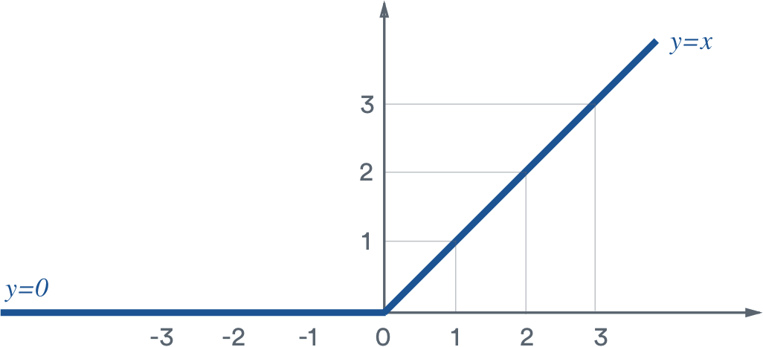
ReLU Activation Function
ReLU stands for rectified linear unit and is a type of activation function.
Mathematically, it is defined as y = max(0, x).
The slope doesn’t plateau, or “saturate,” when x gets large. It doesn’t have the vanishing gradient problem suffered by other activation functions like sigmoid or tanh.
It’s sparsely activated. Since ReLU is zero for all negative inputs, it’s likely for any given unit to not activate at all. This is often desirable (see below).

Slide 26
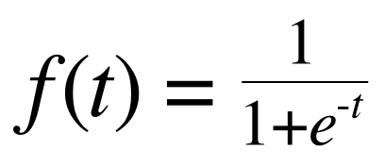
Sigmoid Activation Function
f(t) -> (0, 1)
e = 2.71828
t = input value
A sigmoid function serves as an activation function in our neural network training.
The sigmoid function converts our output values between 0 and 1.

Slide 27
import tensorflow as tf from tensorflow import keras from tensorflow.keras import layers def build_model(): model = keras.Sequential([ layers.Dense(64, activation='relu', input_shape=[len(train_dataset.keys())]), layers.Dense(64, activation='relu'), layers.Dense(1) ]) optimizer = tf.keras.optimizers.RMSprop(learning_rate=0.001) model.compile(loss='mse', optimizer=optimizer, metrics=['mae', 'mse']) return model
model = build_model()
Example of ANN Build
Optimizer that implements the gradient descent.
Notes:
In statistics, overfitting is "the production of an analysis that corresponds too closely or exactly to a particular set of data,and may therefore fail to fit additional data or predict future observations reliably".

Slide 28
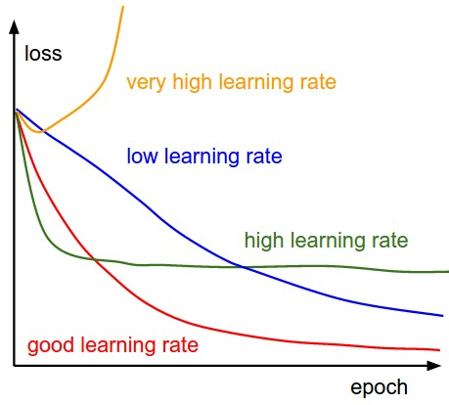
Learning Rate
“… learning rate is a tuning parameter in an optimization algorithm that determines the step size at each iteration while moving toward a minimum of a loss function”.
Murphy, Kevin P. (2012). Machine Learning: A Probabilistic Perspective. Cambridge: MIT Press. p. 247. ISBN 978-0-262-01802-9.

Slide 29
import tensorflow as tf from tensorflow import keras from tensorflow.keras import layers def build_model(): model = keras.Sequential([ layers.Dense(64, activation='relu', input_shape=[len(train_dataset.keys())]), layers.Dense(64, activation='relu'), layers.Dense(1) ]) optimizer = tf.keras.optimizers.RMSprop(learning_rate=0.001) model.compile(loss='mse', optimizer=optimizer, metrics=['mae', 'mse']) return model
model = build_model()
Example of ANN Build
Define the metrics to model’s training.
Notes:
In statistics, overfitting is "the production of an analysis that corresponds too closely or exactly to a particular set of data,and may therefore fail to fit additional data or predict future observations reliably".

Slide 30
Normalized data (-1 <-> 1)
EPOCHS = 1000 history = model.fit( normed_train_data, train_labels, epochs=EPOCHS, validation_split = 0.2, verbose=0, callbacks=[callback_ann()]) print('\n')
Labels with the target
Fraction of the training data to be used as validation data. The model will set apart this fraction of the training data, will not train on it, and will evaluate the loss and any model metrics on this data at the end of each epoch.
Example of ANN Training

Slide 31
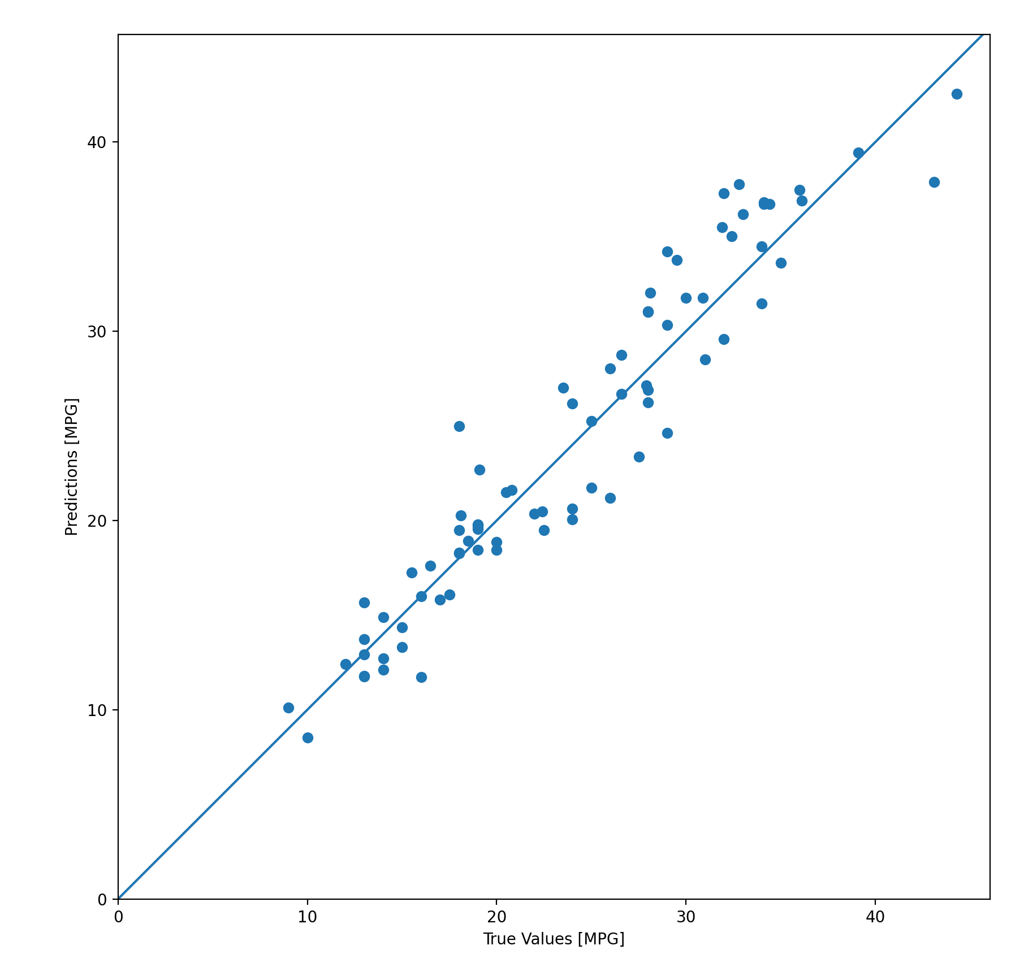
test_predictions = model.predict(normed_test_data).flatten() plt.scatter(test_labels, test_predictions) plt.xlabel('True Values [MPG]') plt.ylabel('Predictions [MPG]') plt.axis('equal') plt.axis('square') plt.xlim([0,plt.xlim()[1]]) plt.ylim([0,plt.ylim()[1]]) _ = plt.plot([-100, 100], [-100, 100]) plt.show() error = test_predictions - test_labels plt.hist(error, bins = 25) plt.xlabel("Prediction Error [MPG]") _ = plt.ylabel("Count") plt.show()
Example of ANN Prediction

Slide 32
Code example
CANVAS:
first_neural_net.py
auto_mpg_data.csv

Slide 33
Computational Intelligence (TC2023)

